Slide 1


Ctrl-Alt-Elite
Team: Dhruv, Kavya, Sydney, Juhi, Pritom
Sponsors: William J. La Cholter and Matthew Elder
Faculty Incharge: Dr. Bhavani Thuraisingham

Slide 2
“ X's economic espionage has reached an intolerable level, and I believe the US and our allies in Europe and Asia have an obligation to confront X and demand they put a stop to this piracy.”
U.S. Mike Rogers, October, 2011
“ It is unprofessional and groundless to accuse the X’s Military of launching cyber attacks without any conclusive evidence.”
X Defense Ministry, January, 2013

Slide 3
Overview
Introduction
Final Progress
Dataset
Data Processing
Machine Learning Model
Results of ML
Conclusions/Lessons Learned

Slide 4
Introduction
What is Cyber-Attack Attribution using Malware Artifacts?
Cyber-attack attribution using malware artifacts is the process of attempting to trace back a piece of code or malware to a perpetrator of a cyberattack
What is our focus?
Use Machine Learning to attribute a nation-state sponsored APT malwares to the source country.

Slide 5
Final Progress
Data Preprocessing
Data Collection
Extensive data pre processing was adopted to customise into desired data
Extracted data from Github and VirusTotal
Analysis Technique
Building Machine Learning Classifier
Determined which analysis technique to use
Trained and Tested on Random Forest Classifier
Creating our own dataset
Fetched attributes from VirusTotal’s reports

Slide 6
Dataset
GitHub Repo, containing ~4,500 country-sponsored malware samples.
PEiD, detecting packed and unpacked malwares.
Packed Malwares were eliminated.
Unpacked Malwares, with 3591 samples used for analysis.
VirusTotal Developer API, used in fetching reports for the malware samples.

Slide 7
Data Extraction and Preprocessing
Attributes extracted from VirusTotal and converted as raw dataset:
Resource
APT group
pe-entry-point
pe-resource-langs
imports
3591 malware samples corresponding to 12 APT groups
Attributes with numerical values (pe-entry-points) were kept unchanged
imports and pe-resource-langs encoded using one hot encoder
APT group encoded using label encoding
729 rows with null values for pe-entry-point removed
148 features and 2862 rows in the preprocessed data.

Slide 8
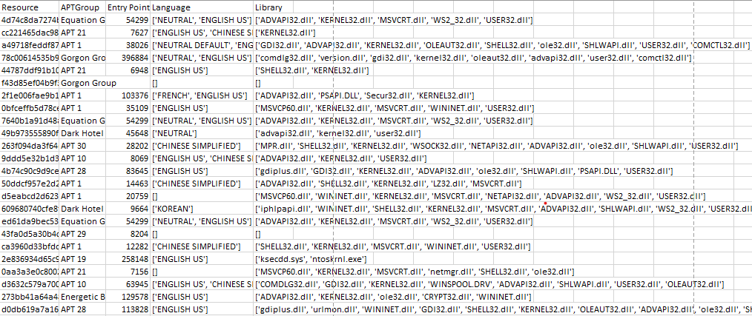
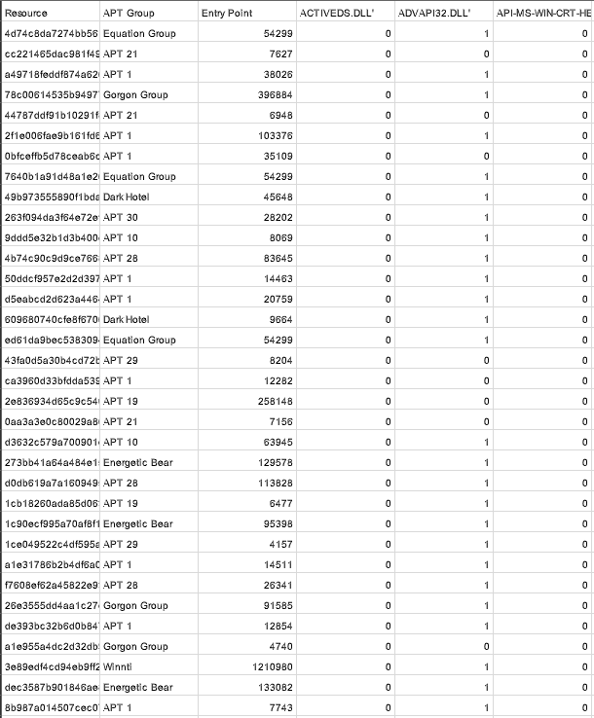

Slide 9
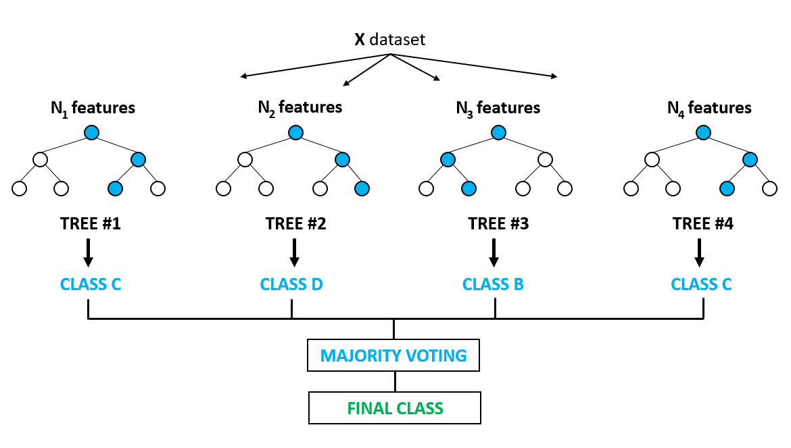

Machine Learning
Random forest classifier model
70% data was assigned to training and 30% to testing
Used scikit-learn RandomForestClassifier

Slide 10
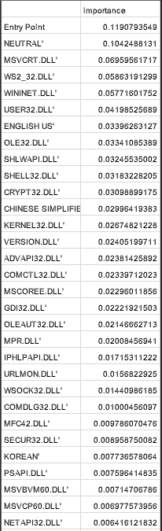
Results of ML
58% initial accuracy
83% accuracy after hyperparameter tuning
Cross validation to validate the results of model
86% accuracy for 20 fold random cross validation
“Entry point” was the most valuable artifact

Slide 11
Conclusion
Model was quite effective even with less features and less data.
Accuracy may increase with more features and more training data.
Less features due to time constraint
Lack of availability of APT Malware datasets
Involved rigorous data pre-processing
Generation of Reports from VirusTotal takes 14 hours.

Slide 12
Future Scope
Dynamic analysis
Live Dashboard
Neural network classification
Hosting the model over Website and updating it as newer data is available
Deep Learning Techniques may help in better cyber attribution
Extract more features
entropy, no of sections, and lots more

Slide 13
References
[1] Boot, Coen. Applying Supervised Learning on Malware Authorship Attribution. Diss. Radboud University Nijmegen, 2019.
[2] Aylin Caliskan, Fabian Yamaguchi, Edwin Dauber, Richard Harang, Konrad Rieck, Rachel Greenstadt, Arvind Narayanan “When Coding Style Survives Compilation: De-Anonymizing Programmers from Executable Binaries.” N.p., 2015. Web. https://arxiv.org/abs/1512.08546
[3] Ferhat Ozgur Catak​, Ahmet Faruk Yazı,Ogerta Elezaj, Javed Ahmed “Deep Learning Based Sequential Model for Malware Analysis Using Windows Exe API Calls.” PeerJ. Computer science 6 (2020): e285–. Web. https://peerj.com/articles/cs-285/
[4] Haddadpajouh, Hamed ; Azmoodeh, Amin ; Dehghantanha, Ali ; Parizi, Reza M. “MVFCC: A Multi-View Fuzzy Consensus Clustering Model for Malware Threat Attribution.” IEEE access 8 (2020): 139188–139198. Web.
[5] Kaspersky, Eugene, et al. “The Power of Threat Attribution-Kaspersky Threat Attribution Engine” https://media.kaspersky.com/en/business-security/enterprise/threat-attribution-engine-whitepaper.pdf
[6] Rosenberg, Ishai ; Sicard, Guillaume ; David, Eli “DeepAPT: Nation-State APT Attribution Using End-to-End Deep Neural Networks.” Artificial Neural Networks and Machine Learning – ICANN 2017 Lecture Notes in Computer Science, 2017, pp. 91–99., doi:10.1007/978-3-319-68612-7_11.
[7] VirusTotal Developer’s API: https://developers.virustotal.com

